Slide 1

CSS3:
Colors

Slide 2
Module Overview
Opacity
RGBA & HSLA
Gradients
Summary

Slide 3
The degree to which you do not want to see something
Opacity

Slide 4
Opacity & Transparency
.fading {
opacity:
}
.vanished { color:
}
0.75;
transparent;

Slide 5
CSS3 Demos Web Site
DEMO

Slide 6
Different flavors of how to find the color that is “just right”
RGBA & HSLA

Slide 7
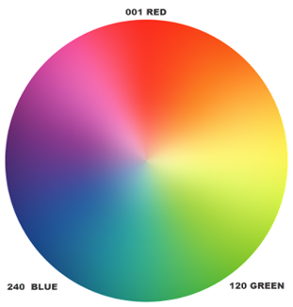
RGBA & HSLA
.darkCloud {
color: #555555;
/* R=55 B=55 G=55 */
/* 55 == (5*16) + 5 == 85*/
}
.smokey {
color: rgba(85,85,85,1);
}
.grayMatter {
color: hsla(0,0%,33%,1);
}
H

Slide 8
A is for Alpha
.vanished {
color: transparent
}
.invisible {
color: rgba(0,0,0,0);
/* or hsla(0,0%,0%,0); */
}

Slide 9
Current Color
div {
color: red;
border: 5px solid currentColor;
}

Slide 10
CSS3 Demos Web Site
DEMO

Slide 11
Blending colors was never so much fun
Gradients

Slide 12
Gradients
.groovy {
background: #FFFFFF; /* fallback */
background: -­‐webkit-­‐linear-­‐gradient (#FF4444, #00AAAA);
background: -­‐ms-­‐linear-­‐gradient (bottom, #FF4444 50%, #00AAAA 50%);
background: linear-­‐gradient (#FF4444, #00AAAA);
}

Slide 13
CSS3 Demos Web Site
DEMO

Slide 14
Summary
How to set opacity and transparency
Understand color options such as
Predefined color names
HEX values
RGBA
HSLA
How to create gradients

